Slide 1
Project O.R.C.A
Luke Waller

Slide 2
Inspiration for the project
Standing bodies of water are continually getting more polluted and this is all ending up in the ocean.
Pollution in the sea is increasing at a rate of 10 million tonnes each year.
Studies suggest by 2050 the amount plastic in the sea will outnumber by the number of fish.
Over 500 dead zones where marine life cannot live.

Slide 3
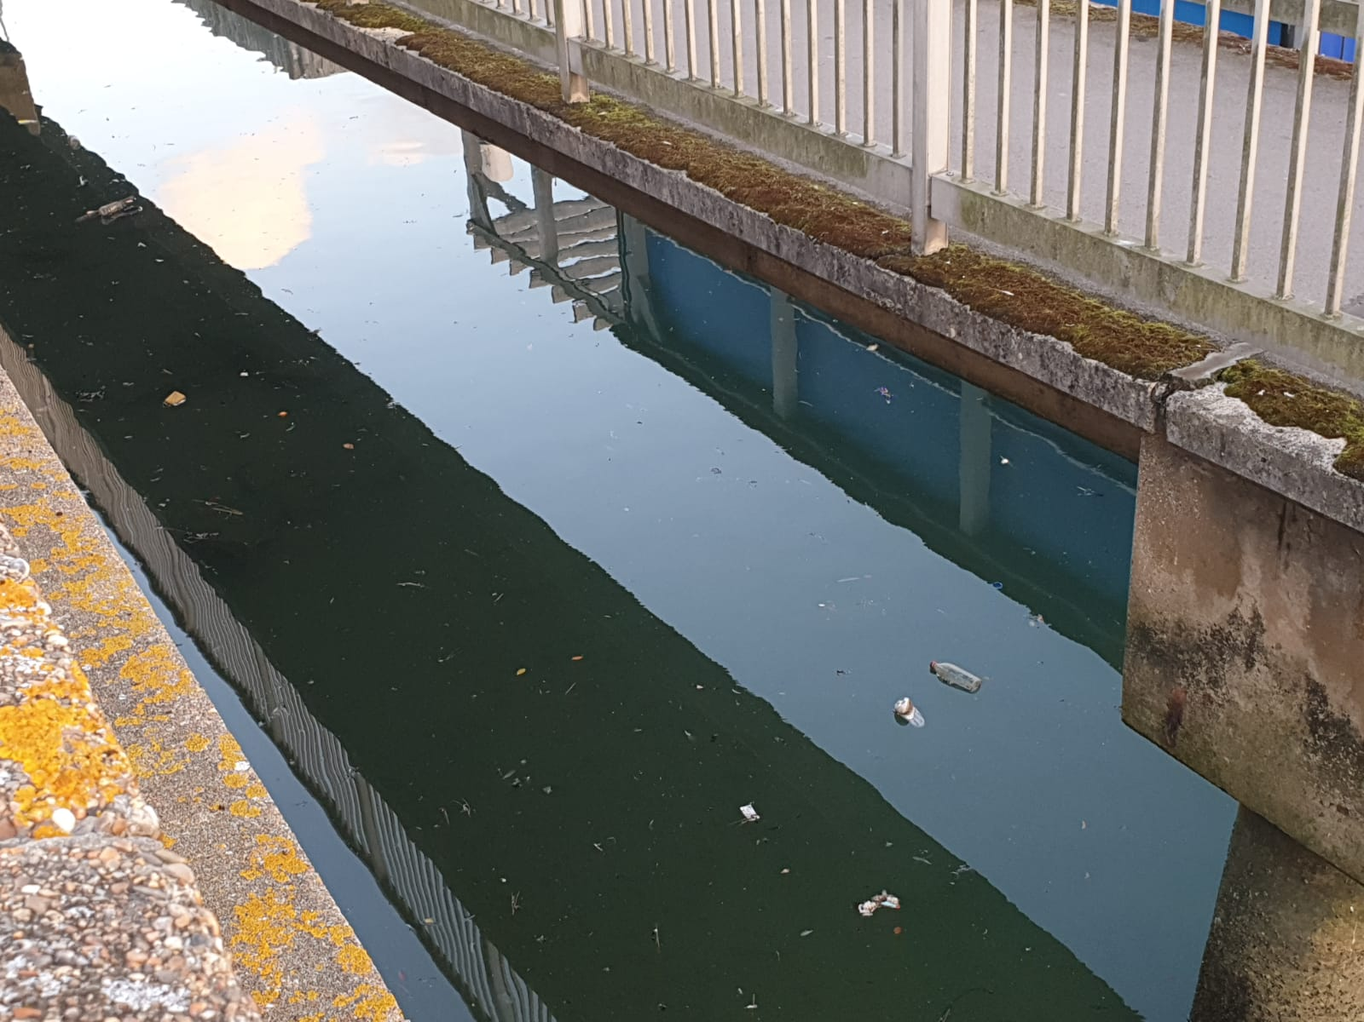
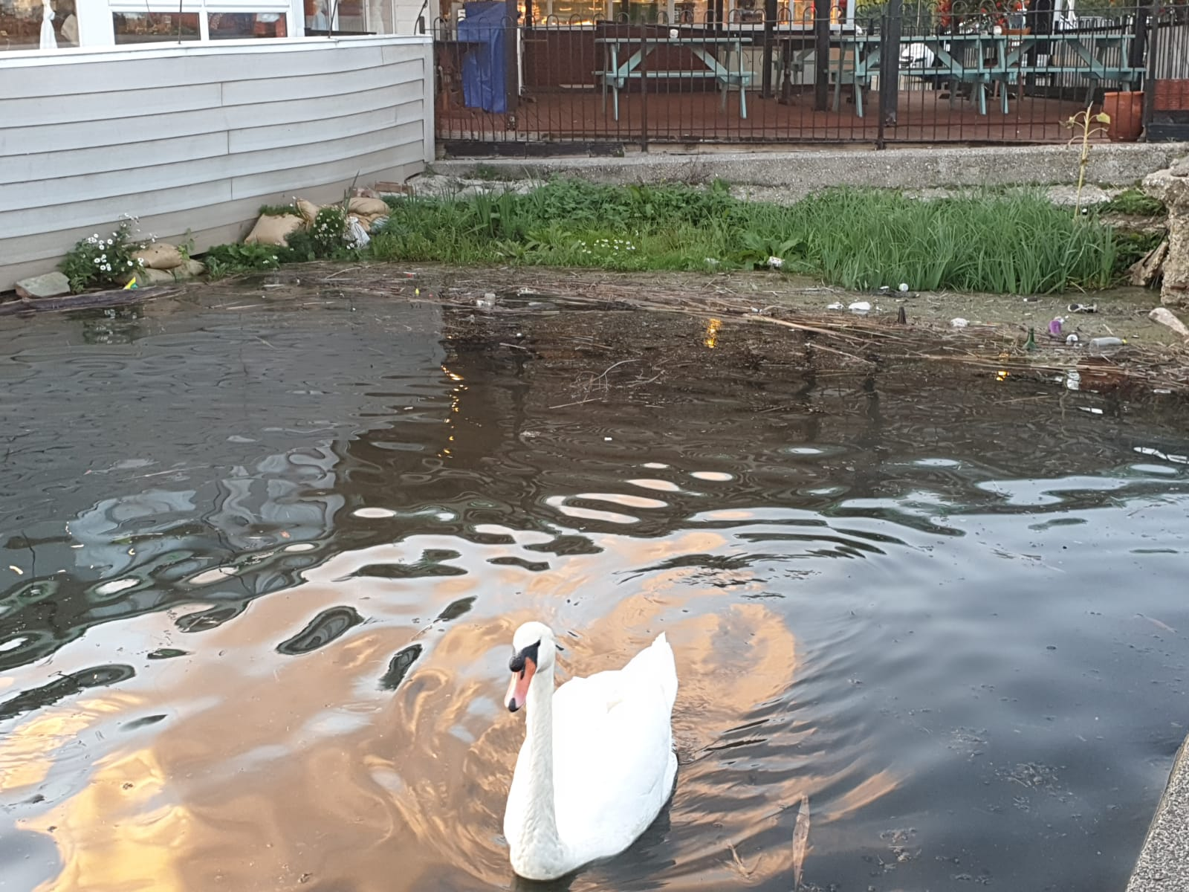
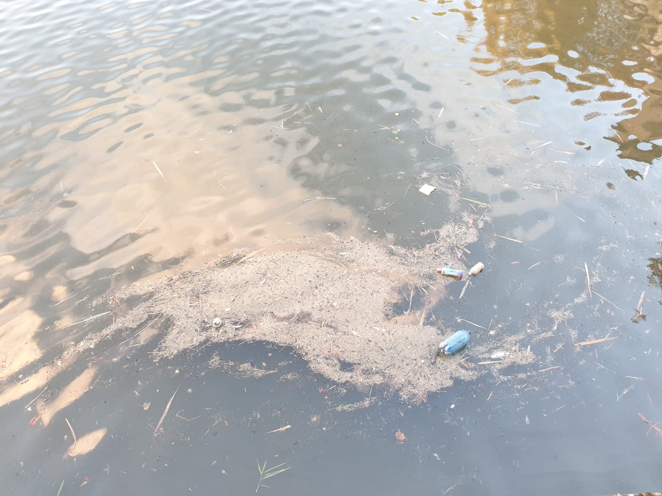
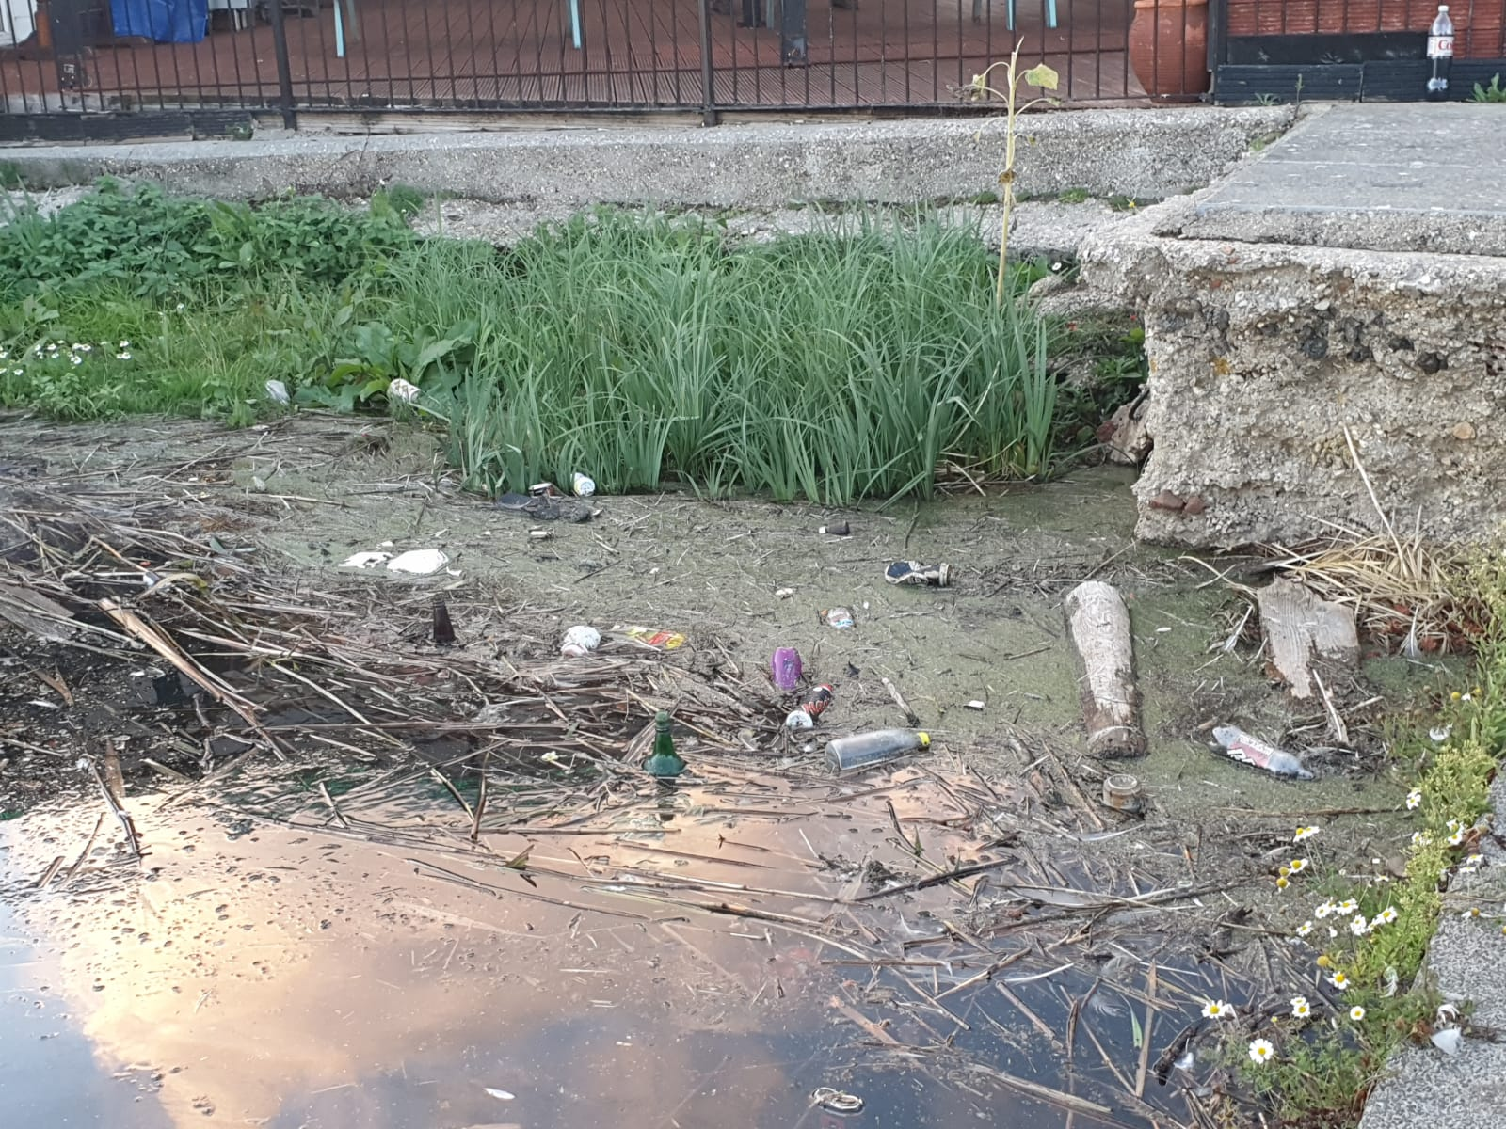
Local images of reservoir in Weymouth
This was one of the biggest inspirations for the project
Lived near this reservoir for over 20 years
Local wildlife lives among it

Slide 4
Initial Project Aims
Create a boat that can float on water
Use a mechanism to scoop/collect the litter
Create a control system for the craft that will allow it to be remotely operated

Slide 5
Project Context – Project Aims
Project in a sentence

Slide 6
Hardware Design
Initial Designs
Prototyping
Finalise Design / Calculations (Bouyancy)

Slide 7
Software Design

Slide 8
What were the issues that needed solving with software?

Slide 9
Software Classes
Ones that I made
Other – nRF24L01

Slide 10
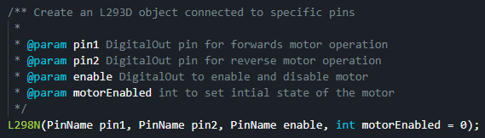
L298N Library
Used to control the Conveyor Motors

Slide 11
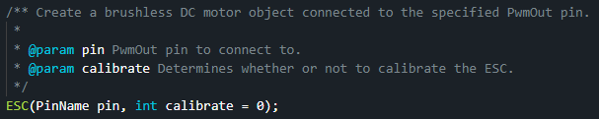
ESC

Slide 12
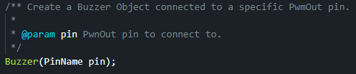
Buzzer

Slide 13
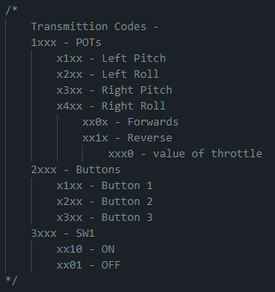
Transmission Protocol
Custom Transmission Protocol
Designed for the hardware used in this project
Expandable for more hardware

Slide 14
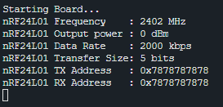
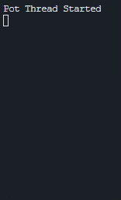
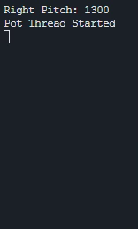
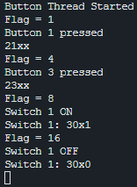
Controller

Slide 15
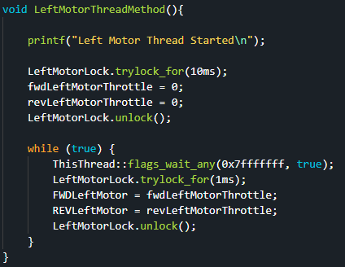
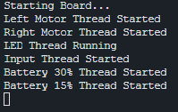
Receiver

